Slide 1

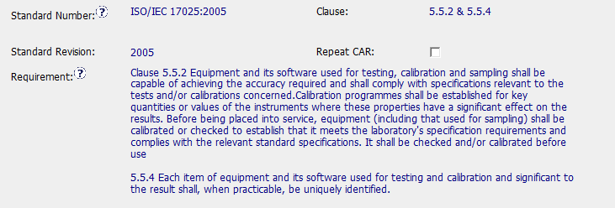
143914280
Observation CAR
Correct Standard, and correct clauses

Slide 2
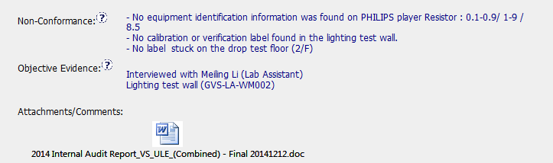

143914280
Non-Conformance and Objective evidence is done extremely well. It clearly pinpoints what was wrong.
And audit report is included for reference

Slide 3

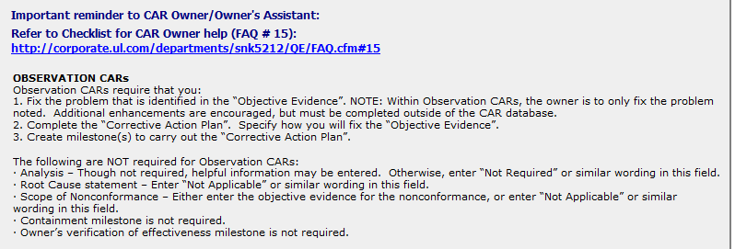
Instructions
CAR provides the owner good instructions

Slide 4

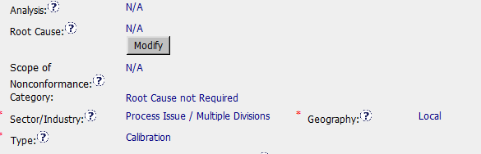
Champion Role
All information completed correctly

Slide 5
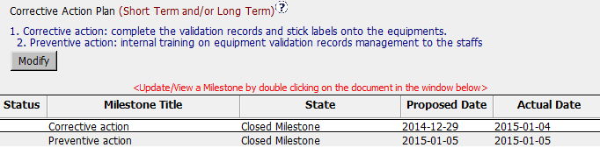
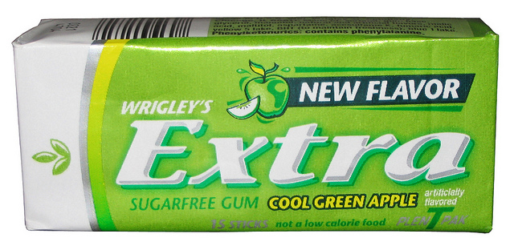
Corrective Action
Above and Beyond what was required
Added preventive action to ensure the issue does not re-occur

Slide 6
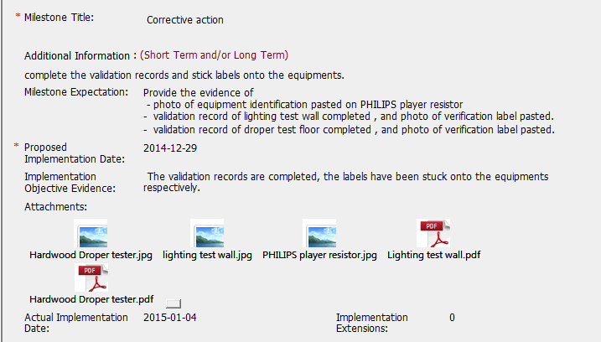
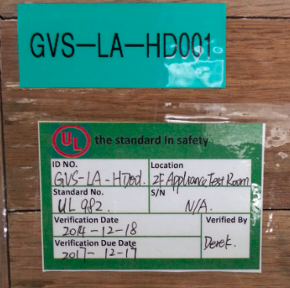
Milestone 1
An excellent job of demonstrating the issue in the CAR was corrected. There are photos which show the fix and documents.

Slide 7
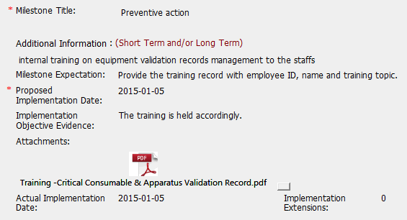
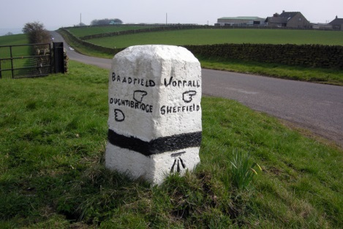
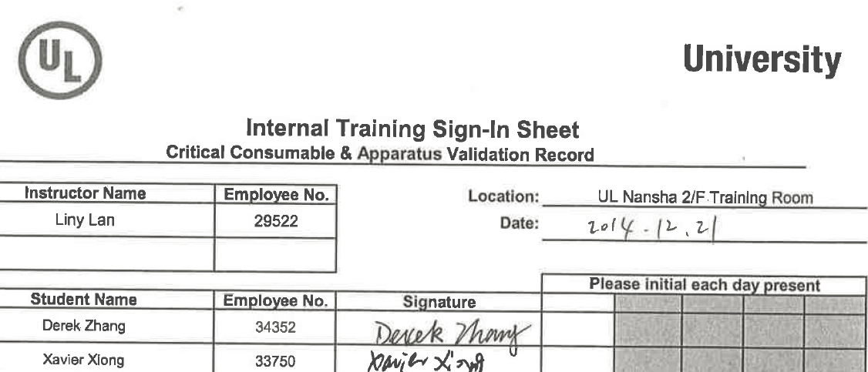
Milestone 2
Provided evidence of training in the attachment.

Slide 8
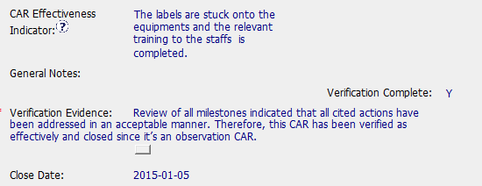

Verification
Good verification effectiveness
Verified the same day it was closed

